Slide 1
CRIMINAL MANAGEMENT SYSTEM

Slide 2
ABSTRACT
The Ceramic management system is the process of managing the book center. Here admin is an only one user to managing this software. Which have do process of purchase, sales and provide available book details. A book store has n number of books are available. So, it’s very hard to manage the ceramic shop.
Ceramic shop Management System is the web application to automate all kinds of operations in the ceramic shop. The purpose of this software is to manage the ceramic software in the book store. Generally, it includes the Order Processing, Stock Management and Accounts Management. We developed this software to maintains records of sales, purchase and staff records. This project developed using Java as front end and SQL Server as Back end. Here we are trying to develop such type system which is provide the automation on the any type of the ceramic shop. That means a shop which has the type system which provides the facility to the customers of the shop to purchase the ceramic product from the shop without any complexity.

Slide 3
HARDWARE SPECFICATION
Processor : P 4 700 GHz.
RAM : 4 GB RAM
Hard Disk Drive : 180 GB

Slide 4
SOFTWARE SPECIFICATION
Operating System : Windows 7/8/10
Front End : JAVA
Back End : SQL

Slide 5
EXISTING SYSTEM
At present, the Wholesale and Retail outlets are working under manual management. The client uses MS Excel, all records related to Products, Sales, Suppliers, Orders, Payment are stored in excel files. there is lot of duplicate work, and chance of mistake. When the records are changed, they need to update each and every excel file. In case of Customer records, all information related to customers and the product which the customer has purchased is to be stored in the Customers excel files. If the changes in the customer profile (like Phone no., Address) occur, excel file must be updated.
Disadvantages
To manage the whole data, the person maintaining records has to take great pain
Various excel files has to be maintained for each separate process
There is no option to find previous saved records. There is no security; anybody can access any report and sensitive data.

Slide 6
PROPOSED SYSTEM
This ceramic Shop Management System is used to overcome the entire problem which they are facing currently, and making manual system to computerized system. -
Purposed ceramic shop management system should help the customers query whether a product in a stock the user can query the availability of a product. The objective and scope of my Project Ceramic Shop Management System is to record the details various activities of user. It simplifies the task and reduce the paper work. Ceramic store management system should generate sales statistics for any period.
Advantages
If customer request for the product and the product is not currently sold by the ceramic shop, then the customer is asked to enter the full detail of the product details for procurement of the ceramic by the ceramic shop.
If the requested product is in stock, the exact number of copies available and the rack number in which the book is located should be displayed.

Slide 7
Modules
Customer Registration
This module will be collecting the all the information about the customer, when customer visit or purchase any product admin has collect the customer details and register here,
Product Registration
This module admin registers the product details, what are the products are available into the ceramic shop, once it’s added it will be stored into the product table.
Purchase
When owner purchasing the product for a shop, it should manage by this module. each and every purchase detail are should be managing here, then only we can maintain the stock details.

Slide 8
Sales
This module is act as an when customer purchasing the ceramic products or anything admin collect the purchase details and sales it. Then it will show the total cost rupees in a sales screen
Stock
This module helps to shown the what are the stocks are available in the shop, we can easily identify the overall stock in the single screen. Also, can able to find the what are the stocks will be close find then can purchase the order.
Billing
This module has to show the billing details for the ceramic shop. We can see the billing detail as a date wise and customer wise. Which can provide the report to the shop

Slide 9

Data Flow Diagram
Level 0

Slide 10
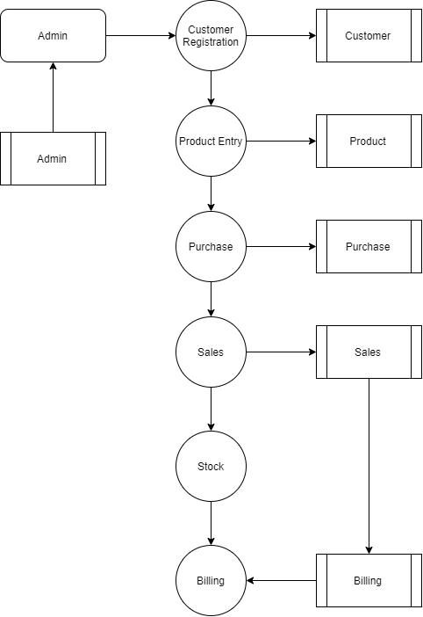
Level 1:

Slide 11
Thank You

